Slide 1
Framing and Composition
Screen Production Essentials - Task 1

Slide 2
Introduction
Framing is the act of choosing what will be included within the frame of your cameras viewfinder.
Composition relates to how the elements included within the frame are arranged to create an aesthetically pleasing image.
You must understand the foundational concepts of framing and composition before you begin filming.

Slide 3
Shot Sizes
The images to follow will give you an overview of the 8 typical shot sizes. Shot size is judged in relation to the person or object within the frame.
These shot 8 shot sizes are often simplified to 3 - Wide shots, Medium shots, and Close ups.
It is essential that you learn the various shot sizes in order to structure and tell your visual stories effectively.

Slide 4
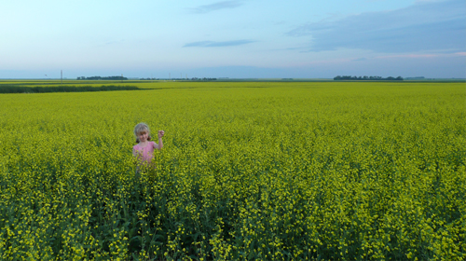
Extreme Long Shot
Usually used as an establishing shot in a scene to give the viewer a broad sense of the world they are entering into.

Slide 5
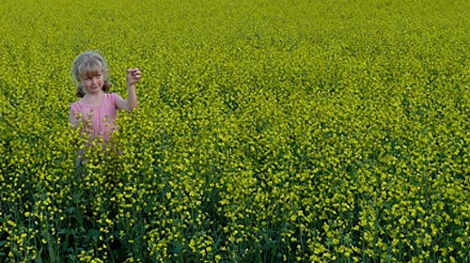
Long Shot
The wide shot it is still quite long but the human element is clearly visible. Again this type of shot is often used to establish a scene.

Slide 6
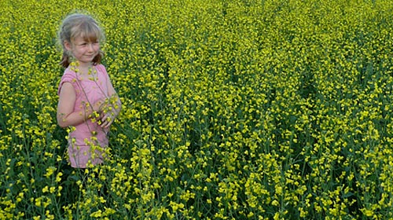
Medium Long Shot
Characters can be seen from approximately the knee up giving focus to the character while still showing the immediate surrounds.

Slide 7
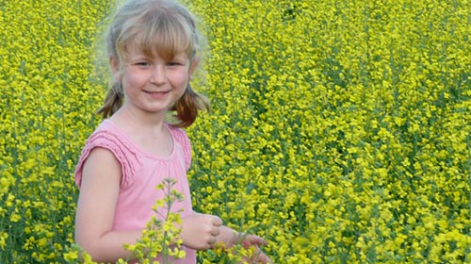
Medium Shot
The medium shot would typically feature the characters waist to the top of their head. A good size to use when introducing dialogue.

Slide 8
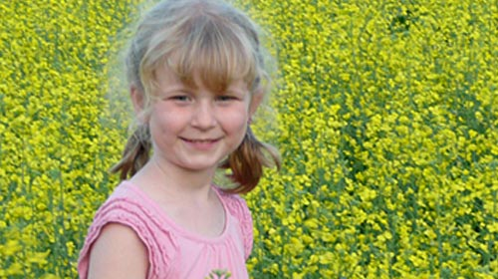
Medium Close Up
The characters expression is much clearer in this shot and it can be used for a tight two shot if the characters are in close proximity.

Slide 9
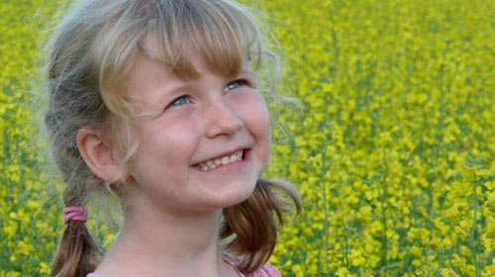
Close Up
As the emotion of the scene increases a director will often choose to shoot individual character close ups to capture the intensity.

Slide 10
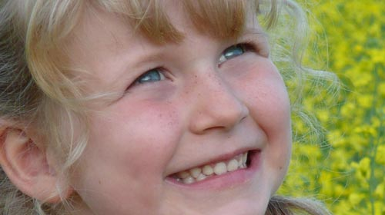
Big Close Up
This type of shot can be used to show extreme emotions, acting as an exclamation mark in a scene if a point needs to be stressed.

Slide 11
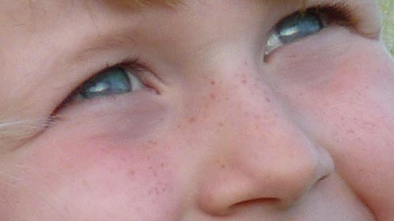
Extreme Close Up
Can be used effectively to create a sense of intrigue or as a cutaway to emphasize detailed character actions or focus in on a small object.

Slide 12
Camera Angles
As a general rule the camera will usually be positioned at the eye level of the main characters. This helps the viewer enter the story at the characters level, thus helping them relate to the central characters on screen.
However other angles are often employed to symbolise a characters internal feelings and their relationship to the other characters.

Slide 13
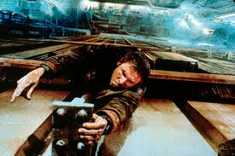
High Camera Angles
High camera angles can be used to make the character being filmed look inferior and powerless. This in turn gives the viewer a sense that they are in the position of authority looking down at the character.

Slide 14
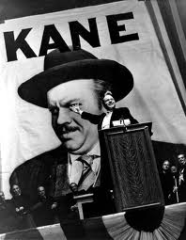
Low Camera Angles
Low camera angles tilted up towards their subject can make the subject look dominating and powerful. This in turn places the audience in the position of being looked down upon and can add to the authority of the character on screen.

Slide 15
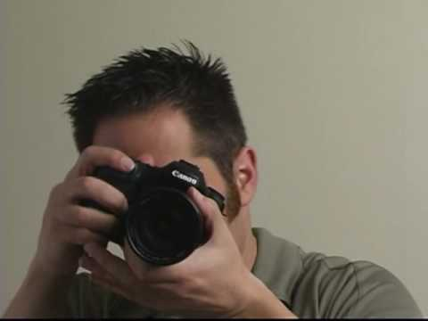
Canted Camera Angle (Dutch Tilt)
This is an off axis tilted shot that is sometimes employed to give a sense of a how a character is feeling. It can be rather unsettling for the viewer and give them an unbalanced feeling which usually mirrors the inner turmoil of characters in the film.

Slide 16
Compositional Technique
How all the elements are arranged (or composed) within the frame is pivotal as to whether an engaging image will ultimately be produced.
The decisions of what to include in the frame and what to omit, the height of the shot, the angle, the camera movement, the lens selection, set design, costume and lighting all play a role in the final shot produced.

Slide 17
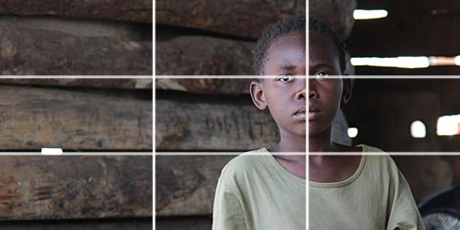
The Rule of Thirds
When everything is divided in two and framed in the center it can make for a very uninteresting image. It is much better to think in thirds. Imagine the frame is divided into thirds horizontally and vertically - the rule of thirds states that objects of interest should be placed on the intersecting invisible lines.

Slide 18
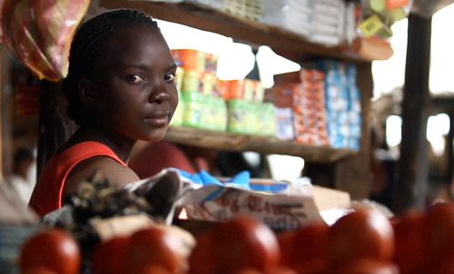
Use of Foreground Images
A great compositional technique that helps create a greater sense of depth in an image is to include foreground elements in the frame. In the image at the market below we get a greater sense of the environment through this compositional technique.

Slide 19
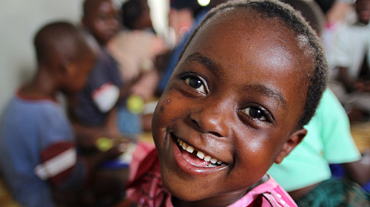
Depth of Field
Another way to draw attention to a particular part of the frame is by using selective focus through adjusting the aperture settings on your camera's lens. This technique can be quite aesthetically pleasing and encourages the viewers eye to focus on a specific part of the frame.

Slide 20
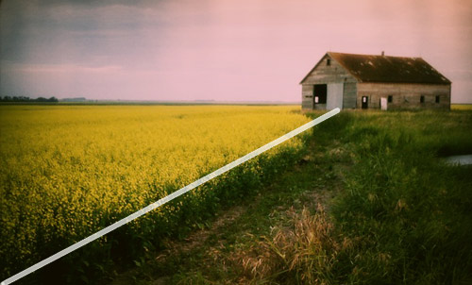
Leading Lines
Another compositional technique used to draw the viewers eye across the frame and toward an object of interest is by using 'leading lines'. These can either be naturally occurring (see field below) or man made lines (i.e. architecture). These lines lead the viewers eye across the frame taking in the scene and landing on the desired point of interest.

Slide 21
Summary
An understanding of the basics of framing and composition is fundamental to producing visually compelling stories. Through practicing the techniques discussed your productions will become much more visually pleasing!

